Slide 1



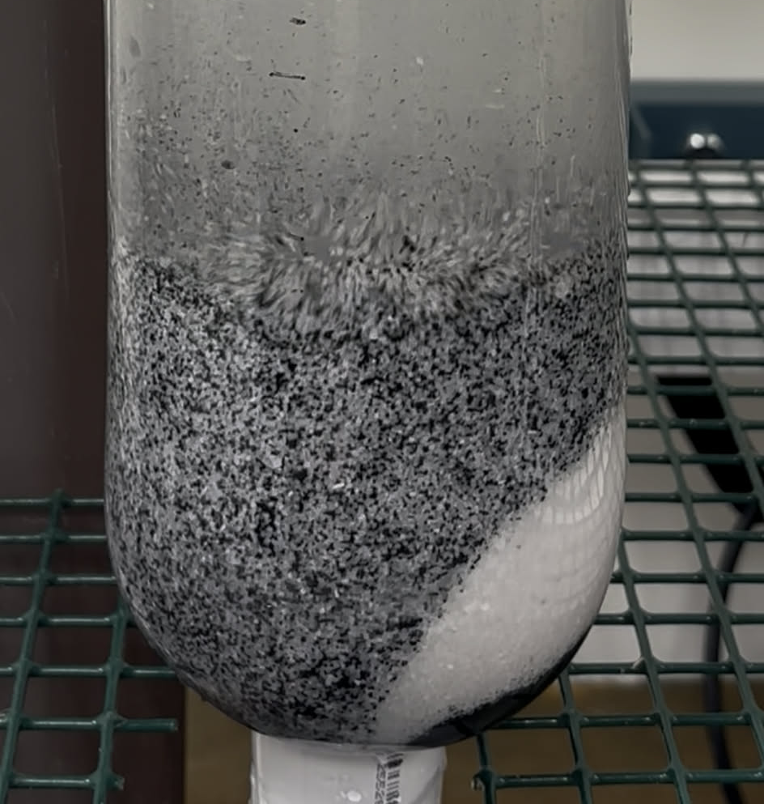
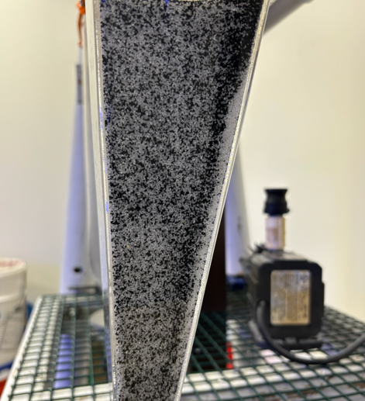
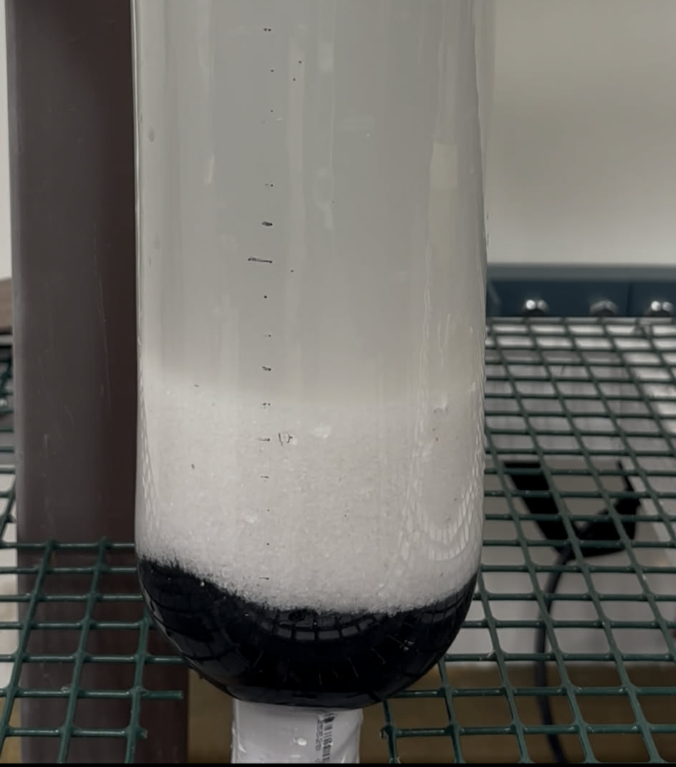
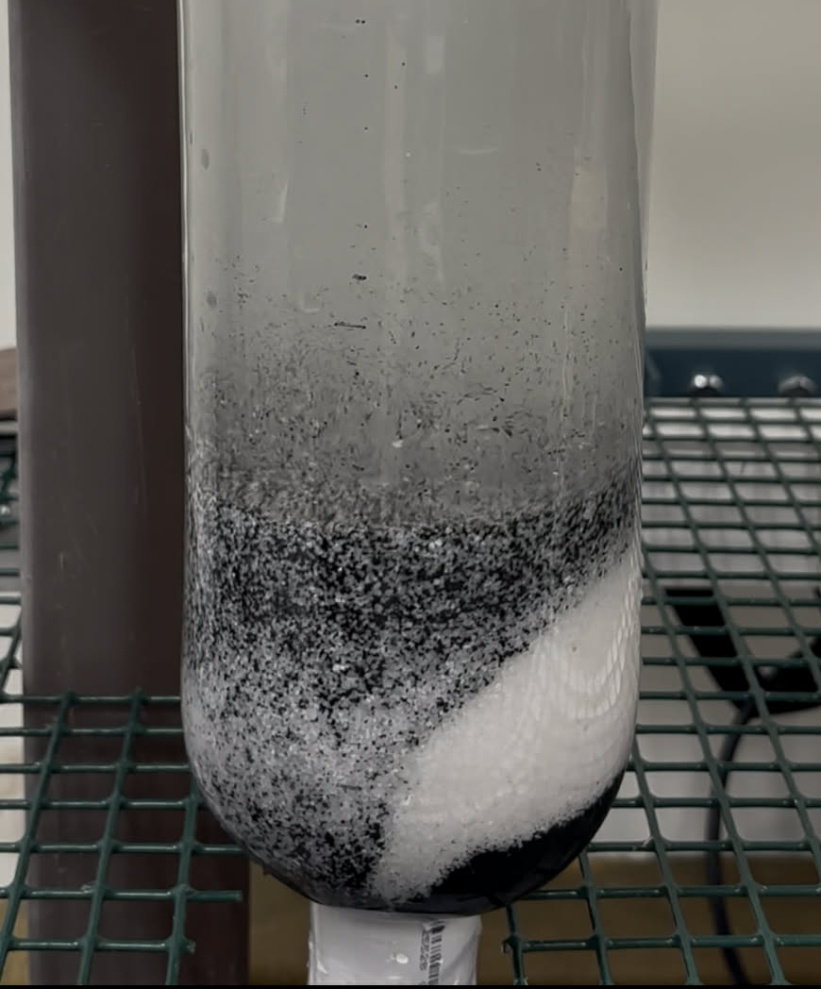
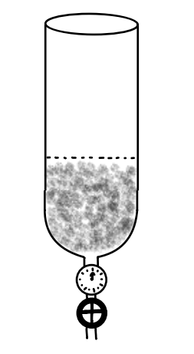
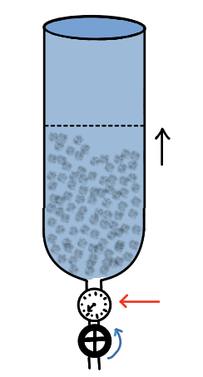
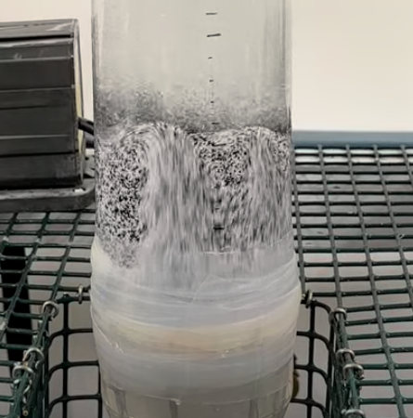
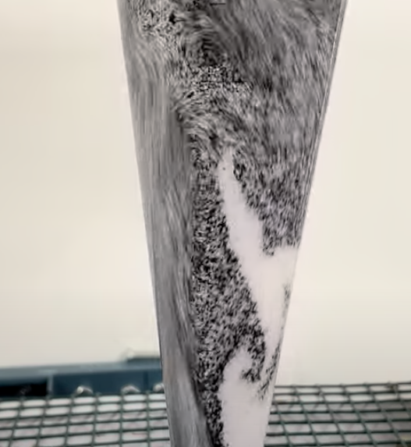
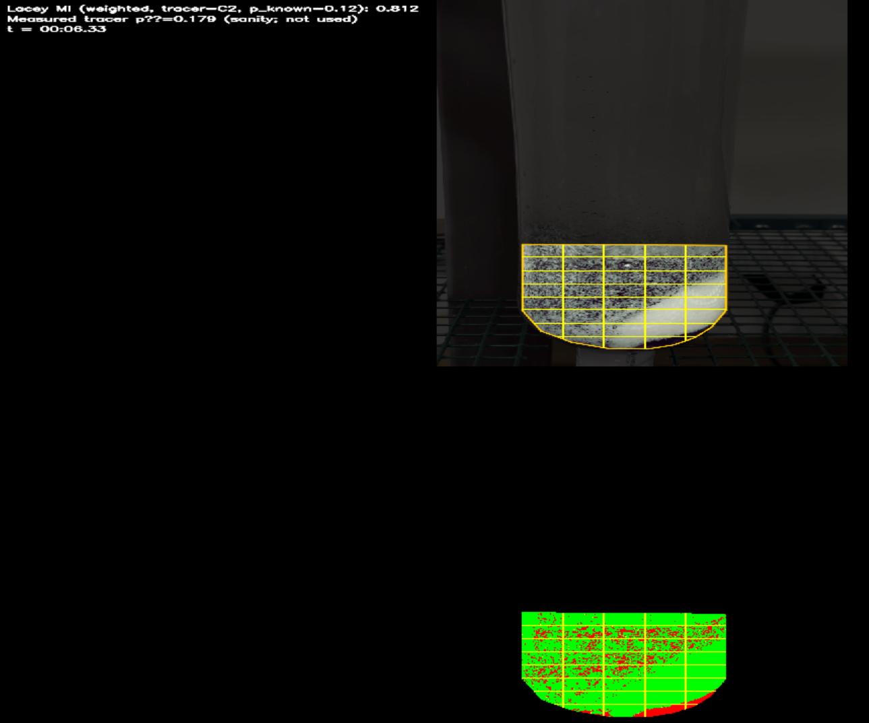
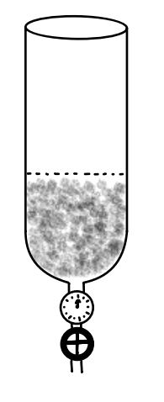
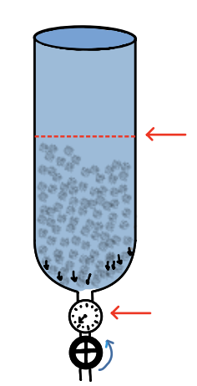
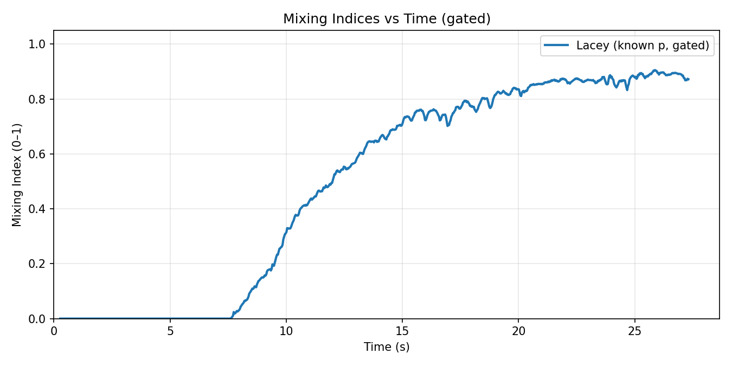
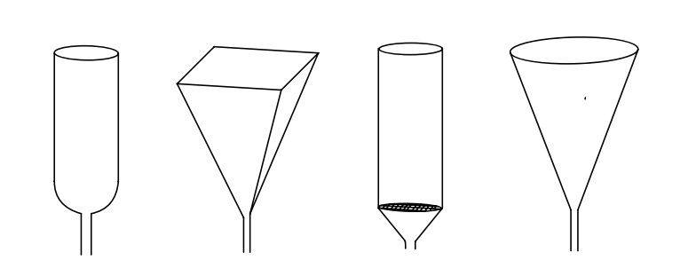
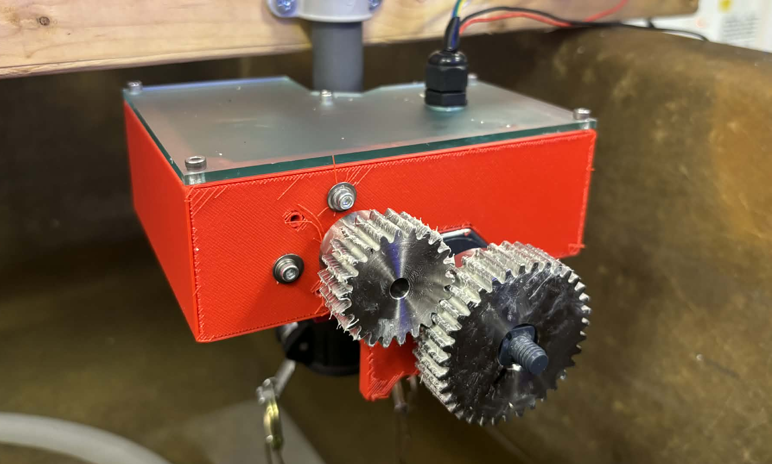
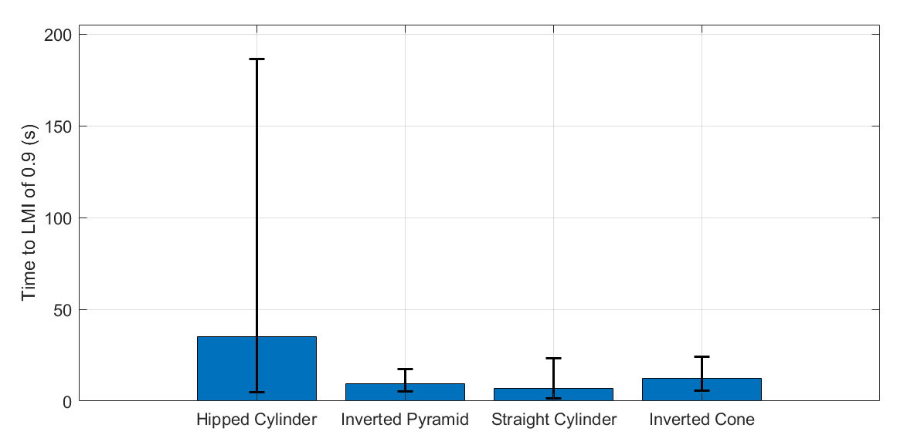
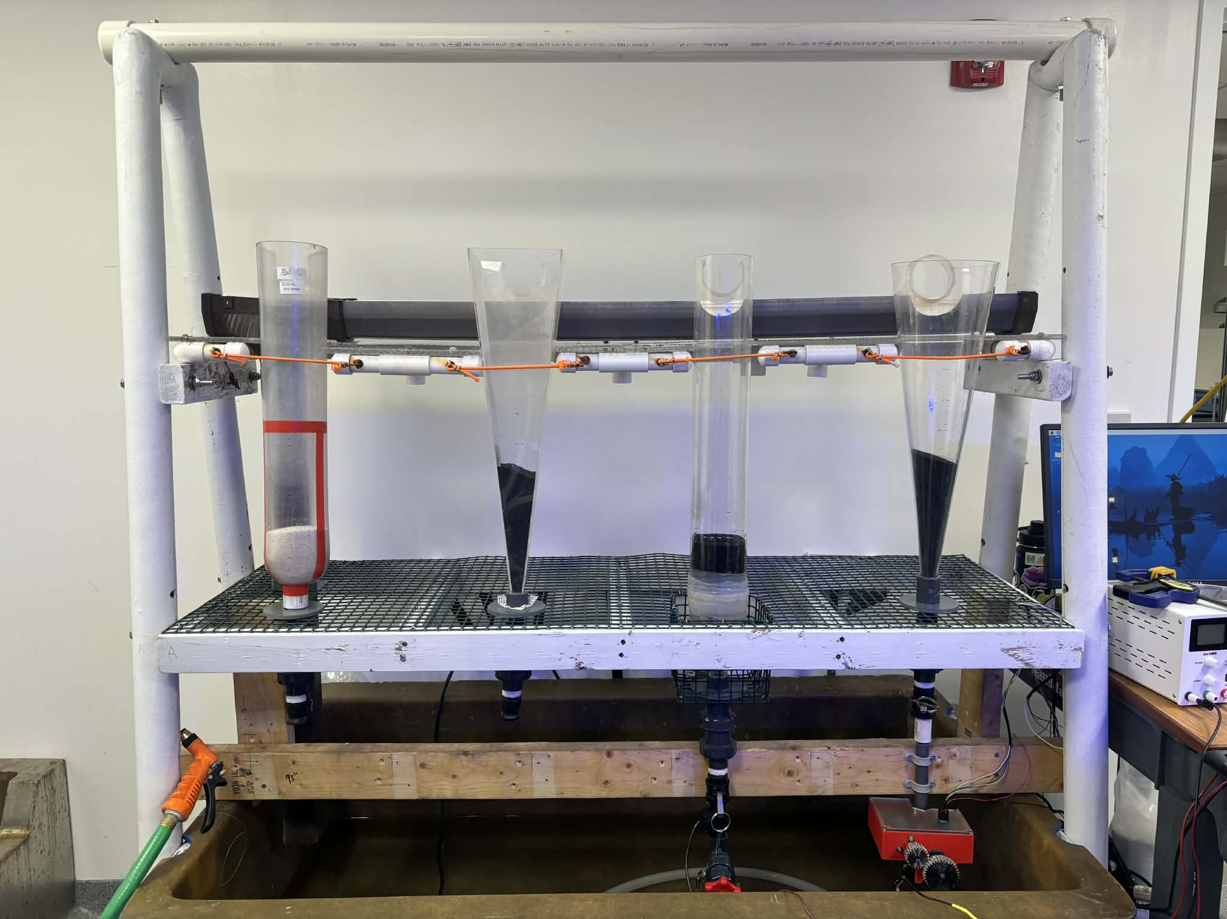
Automated Flow Control and Mixing Performance in Fluidized Bottle Upweller Systems
Jessica Lam ¹ ², Andrew Bennett ¹ ², Michael Triantafyllou ¹ ²
¹ MIT Sea Grant, ² Department of Mechanical Engineering
Motivation
Comparing Flow Strategies
Comparing Silo Geometries
Comparing Silo Geometries
Fluidized bottle upweller systems (BUPSYs) use upward flow to suspend oyster spat, promoting uniform feeding and growth. However, industry-standard criteria for setting flow are not well defined, and little testing has been done to evaluate the effectiveness of different silo geometries. Because growth depends on maintaining a consistent fluidized state over time, this work evaluates flow-setting strategies and silo geometries to quantify their impact on mixing . These insights to inform an automated flow-control system that maintains target operating conditions with reduced labor.
Objective
Measure the input flow (L/min) of the two strategies
Determine the bed expansion that corresponds to onset of fluidization for each silo geometry
Method A: Bed Expansion
Objective
Determine which silo geometry best promotes mixing of spat
Qualitative Observations of Different Silo Geometries
Method
Hipped Cylinder
Limited channelization causes particles move as a single mass rather than mix.
Inverted Pyramid
Geometry-dependent dead zones near the corners resulting in clumps
Objective
Flow and Geometry Testing
Compare flow setting strategies
Testing mixing performance of silo geometries
Automated Flow Control System
Integration of camera and flow sensor to control flow valve
Add a layer of 100 mL black sand to the bottom of the silo followed by 400 mL of white sand
Increase the flow until the fluidized bed reaches 35% expansion
Add 500 ml of sand (size 400 - 700 um) into the silo and mark the packed bed height
Increase flow until fluidized bed height is 135% of the packed bed height and measure flow rate
LMI: 0.71
Measure Tracer: 0.179
Time: 00:06.33
Straight Cylinder
Channelization results in effective mixing; bottom-layer behavior was slightly obscured by tape
Inverted Cone
Asymmetric spiral channel results in effective mixing despite uneven local velocities.
Method B: Onset of Fluidization
Flow Setting Strategies
Strategy A: Increase flow until bed expansion of 35% is achieved
Strategy B: Increase flow until bottom layer of spat is moving (indicating the onset of a fully fluidized bed )
A camera tracks dyed cultch to measure the time to reach a Lacey Mixing Index (LMI) of 0.9, used as a proxy for particle redistribution and mixing effectiveness across silo geometries.
Automated Flow Control System
System Overview
Results
Overhead camera measures bed height in real time
Motorized valve adjusts flow to maintain target expansion
PD controller compensates for disturbances (e.g., pump drift)
Example plot of LMI as a function of time (Hipped Cylinder)
Control Loop
Add 500 ml of sand (size 400 - 700 um) into the silo and mark the packed bed height
Increase flow until bottom layer of sand just begins to move; mark the measured flow rate and the fluidized bed height
PD Controller
Motorized Flow Valve
Silo Geometries
Target Bed Height
Fluidized Bed
Results
Camera measuring bed height
Average Flow Valve Corresponding to 35 % Bed Expansion and Onset of Fluidization Different Silo Geometries
Hardware
Silo Geometry | Bed Expansion Flow | Onset Fluidization Flow
Hipped Cylinder | 15 L/min | 13 L/min
Inverted Pyramid | 11 L/min | 10 L/min
Straight Cylinder | 14 L/min | 13 L/min
Inverted Cone | 10 L/min | 9 L/min
Time for each Silo Geometry to reach a LMI of 0.9 where flow is set for 35% Bed Expansion
Motor housing clamps to existing valve and gear train drives valve position
Hipped
Cylinder
Inverted Pyramid
Straight
Cylinder
Inverted
Cone
Bed Expansion corresponding to Onset of Fluidization for Different Silo Geometries
Conclusion
Silo Geometry | Bed Expansion
Hipped Cylinder | 27%
Inverted Pyramid | 23%
Straight Cylinder | 27%
Inverted Cone | 24%
Key Takeaways
Silo geometry does not significantly affect mixing time, but greatly influence flow patterns
Bed expansion is a reliable, observable metric for achieving fluidization, but does not consider oyster growth
BUPSY setup used for testing flow setting strategies and silo geometries.
*error bars are calculated for 95% confidence interval in log space and n=3 trials
Next Steps
Integrate dense optical flow with bed expansion to dictate flow
Field validation with live oysters to link flow profiles to growth
Notes:
Integrate dense optical flow with bed expansion to dictate flow
Multi-silo scaling
Testing in farm setting with oysters to relate flow profile to spat growth rates and mortality

